Slide 1

Webinar RIPESS
April 17, 2020
Eri Trinurini-Adhi
The Bina Swadaya Foundation member of ASEC
Notes:
My name is Eri from Indonesia. I work for Bina Swadaya Foundation, member of ASEC and RIPESS. Together with me my college Mr Wahyudi Anggoro Hadi, the head of village Panggung Harjo in Jogyakarta, which will share on the village initiative inresponding the pandemic.

Slide 2
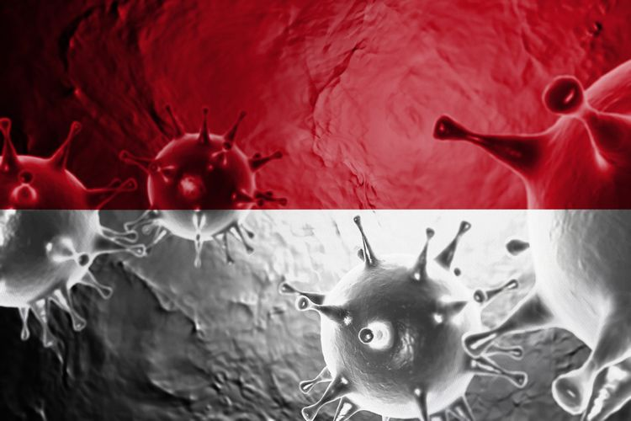
Update status
Covid-19 Statistic (16 April)
  Positive: 5,516
  Recovered: 548
  Death: 496
Government to respond Covid-19
  Status of National Disaster
  Lockdown
  Social protection for the poor and and vulnerable
Notes:
At the first I want to update the situation of the corona virus in Indonesia.
Since 16 April it has more than 5 000 people infected, with more than 500 people recovered and the death toll of 496/
To this situation, the government has announced the status of national disaster and call for lock down for provinces regarding their priorities
Accompany to the lockdown, the fiscal and non fiscal respond have been prepared. The social safety nett program has been established to protect the poor and venerable people, thas is including the cash for work and cash conditional transfer for more than 10 million households

Slide 3
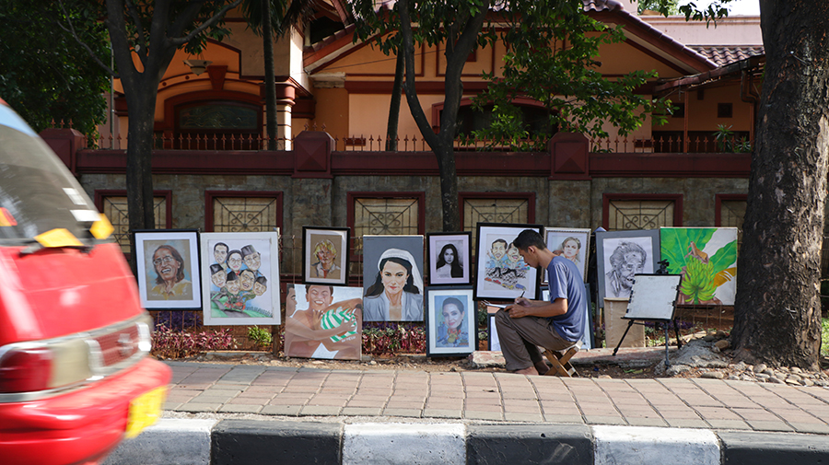
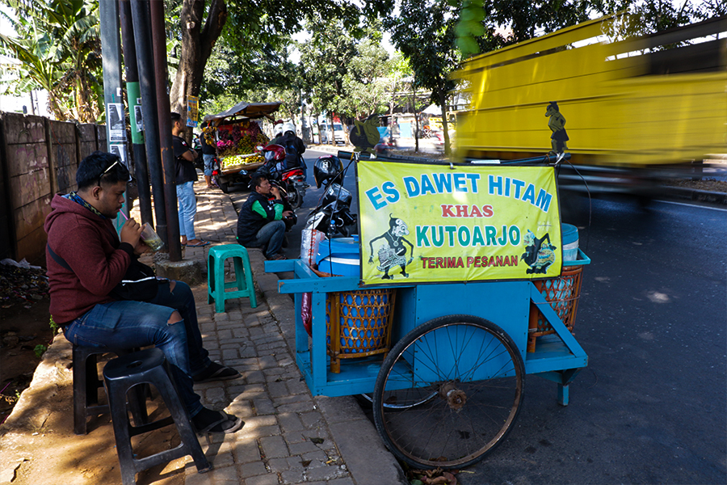
General challenges
4th dense population (270 mil), 50% living in Java Island
Generally insufficient health system
Low awareness in hygiene behavior
May is fasting month for Islam and the Eid in June. The custom of people to going back home (family gathering) in Eid. Challenges in spreading the corona virus to more provinces and villages
99% enterprises are micro level and informal sector, they are fragile to fall into poverty. 1% big enterprises with the significant influence for economy
80% of the food and agriculture product produced in villages as well as periphery of cities (excluding import)
Notes:
In this slides I want to give you more illustration on the challenge of Indonesia in facing the pandemic.
- With a population totalling around 270 million individuals, Indonesia is the fourth-largest country in terms of population size.
50% of this is living in Java. So this density has brought more challenge to practicing social distancing.
- In general the health support system in not yet adequate in all provinces. The infrastructure for good sanitation is not yet adequate particularly in the poor villages and slum areas. Access to water remains a problem on some area
-The awareness of hygiene behaviour is low,.All situation is not supportive in fighting the corona virus
- Social life is important for many Indonesian. In May it will be the fasting month or Ramadhan for Islam and it will end with the Eid in June. It is the custom for Indonesia to coming home and celebrate the Eid with the family. Every ear in this month it will be an exodus from the city to the villages. This situation will accelerate the spreading of the virus.
- 99 % of the enterprises are ultra micro and micro levels, they are mostly work in informal sector. This group is more vulnerable affected by the social distancing policy, they loss the daily income and cannot to buy food for family. However only 0.1% the enterprise is a big scale but has significant influence to economy. Without the pandemic, Indonesia is facing problem on economic equality.
- Regarding to the food, 80% of the agriculture product is produced in the villages, so to ensure the food security during the pandemic, agriculture production and suplly-chain have to be ensured.

Slide 4
National Commission on Violence Against Women statement
RECOMMENDATION
Affirmative action by supporting the female paramedic, elderly and disability and poor women
Provide online and non online learning method for education including for disabilities
Social protection for informal sectors, elderly and disabilities in the village
Activate the community health center to ensure the nutrition for the mother and child
Disadvantage situation for women
Limitation of health protective equipment> female paramedics
Women working in service areas such as receptionist, marketing, traditional market
Poor women is more vulnerable due to in adequate nutrition and sanitation
Notes:
The civil society represented by the national commission on violence against the women has send their concern to the government
Disadvantages situation for women during the pandemic and social distancing:
1. Limitation of heath protective equipment has put the risk of lot of female paramedic.
2. Women working the service areas, such as receptionist, marketing, and traditional market are sensitive to be infected
3. Poor women is more vulnerable, because they have inadequate nutrition and water sanitation.
4. Work from home has bring more work for mother, they have to accompany the children in doing the online learning, cooking and working in the same time. In other side, the husband has loss the job. This can be potential to increase violence.
Recommendation to the government are:
Affirmative action by supporting the female paramedic, elderly and disability and poor women
Provide online and non online learning method for education including for disabilities
Social protection for informal sectors, elderly and disabilities in the village
Activate the community health center to ensure the nutrition for the mother and child

Slide 5
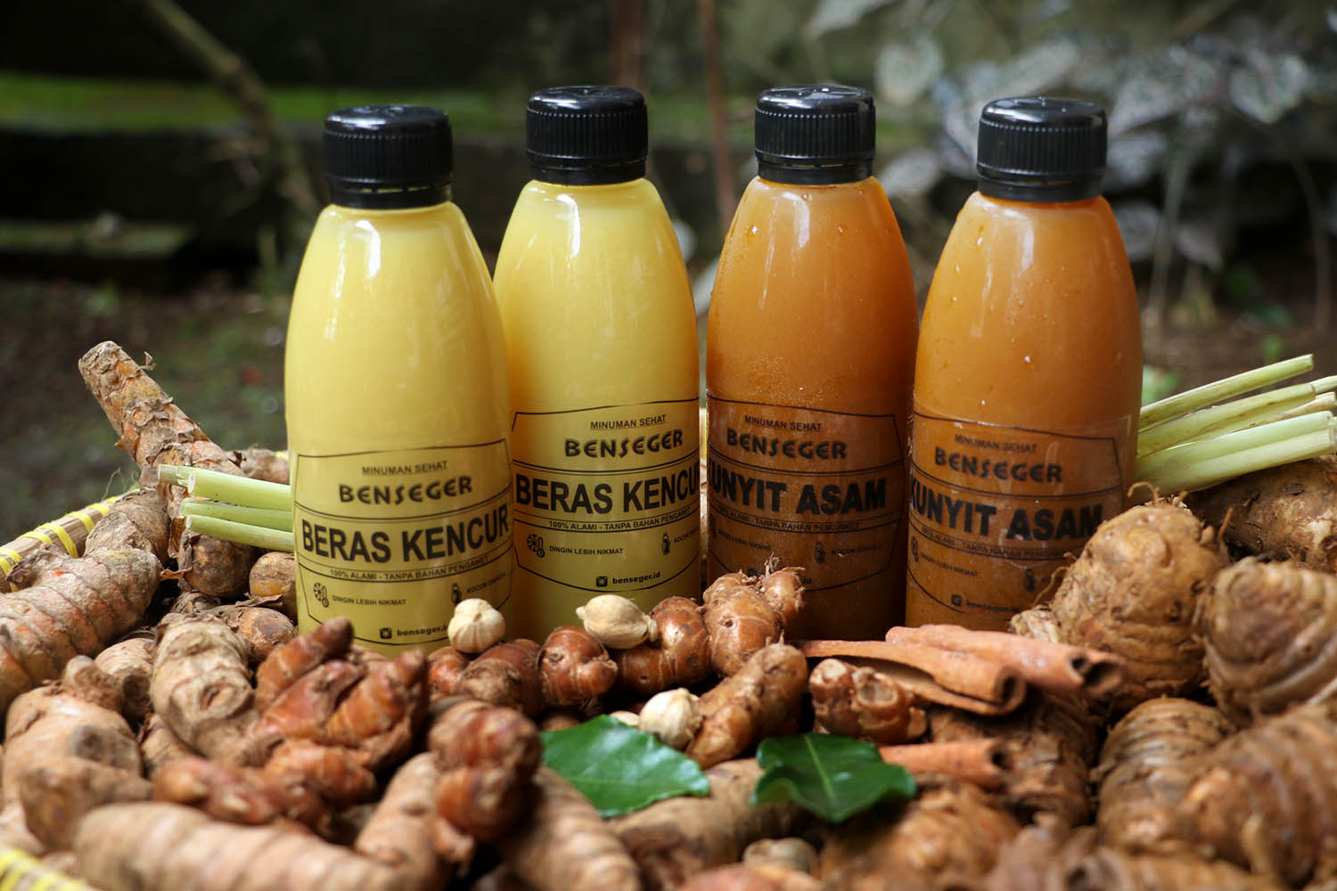

Potential and strengths
The herbs and spices are good for healthiness, and these are local produced
Gotong royong (social capital) of most Indonesian remains existed, particularly in the disaster situation.
The role of civil society including faith-based organizations in raising awareness and solidarity action
Notes:
-According to the research, herbs and spices are good to healthiness and it can improve the immune. Spieces and herbs are home in Indonesia. The people are used to consume herbal drink. This situation give advantage to the farmers.. The demand for spicies such a ginger are increased
-Gotong royong or working together, the form of social capital in Indonesia remain exist particularly in the disaster situation. A lot of solidarity initiatives are found in many forms such as awareness raising, providing the health protective aquipement and providing food for the poor.
The role of civil society including religion based organization seems effective to support the government program on social distancing/

Slide 6
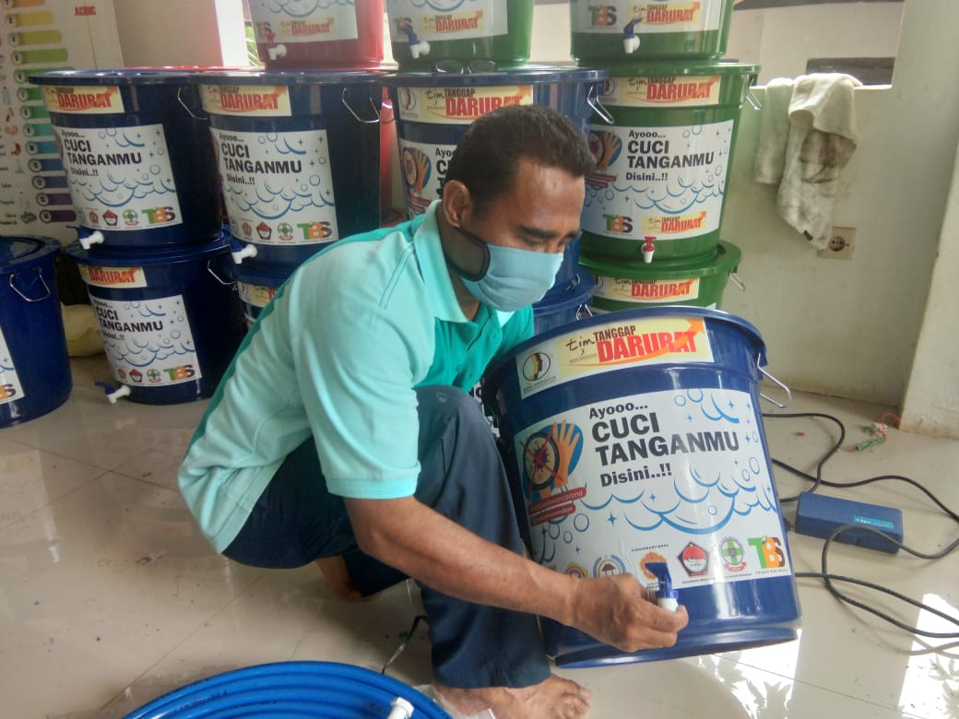
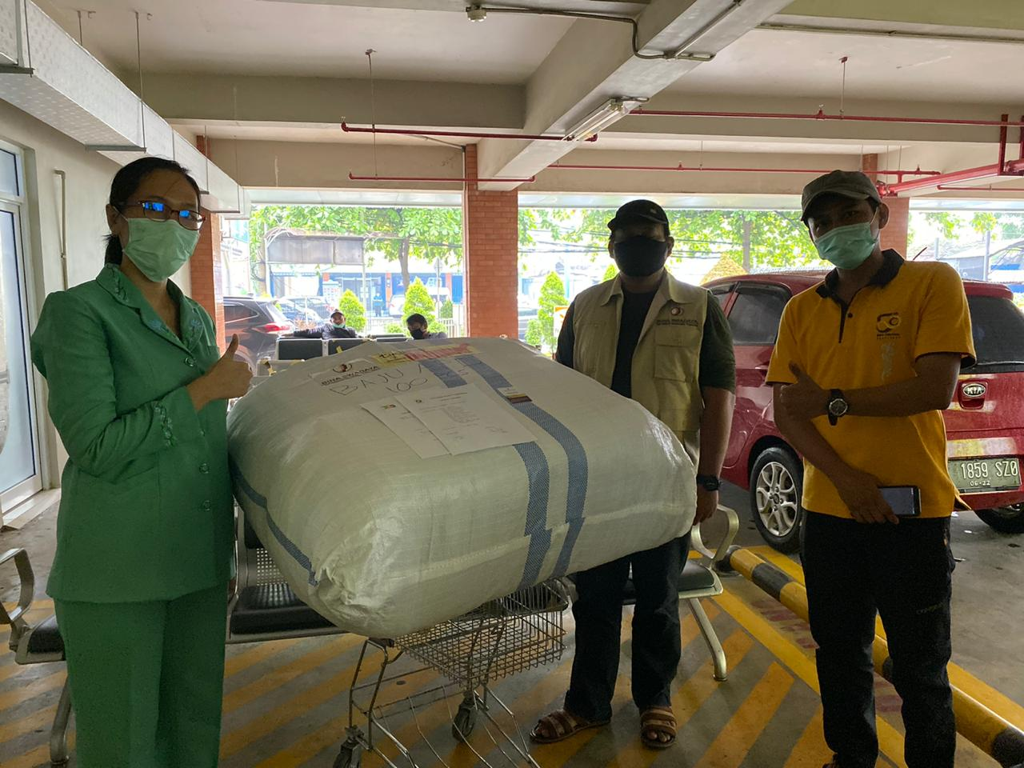
What has been done:
Government
  Fiscal
  Non-fiscal
Private sector
Mostly the hold the activities, many of them lay of the workers
Some can survive particularly which relate to the online delivery and health kits.
NGOs/SSE enterprises
Revise the business plan and run the contingency plan, put the people and beneficiaris as priorities
Conduct emergency respond activity (water container for hand washing, providing personal protective equipment for the paramedic, masker, campaign to stay home etc.
Notes:
All stakeholders have done from according their role: _ together we fight the pandemic
- The government has prepared the fiscal and non-fiscal measurement , but the implementation is the challenges the coordination between the central and local government is necessary
- The private sector/industries mostly hold the activities, only some is still active particularly which relate to online delivery and health equipment industry. Unfortunately, many industries has laid off the workers.
- The NGO and social enterprises were hit by this crisis. They have to run contingency plan with put the people as the priorities. But how long it can be survived? The economic relaxation for enterprises seems has the problem in implementation.
The Bina Swadaya as social enterprise, has provide also a quick respond activities such water container for hand washing, providing personal protective equipment for the paramedic etc

Slide 7
Challenge for the villages
01
How can the social assistance reach the poor women, elderly and disable?
02
Data base to quick respond
03
Economic empowerment during pandemic; creative home industry and farming
04
Supply-chain of agriculture product distribution
Notes:
The government in plan to distribute the social assistance immediately to the poor. The challenge is how it can reach the right people. We can ask my friend Wahyudi from the village later on,
Data base is important to have quick and meet the target. How the village will manage it?
Duo to lock down in the cities, many informal workers are going home to the villages. How can village administration empower the village economy? h
As 80% of the food are produced in the village, how can village initiatives to ensure the supply chain of agriculture and village product?

Slide 8
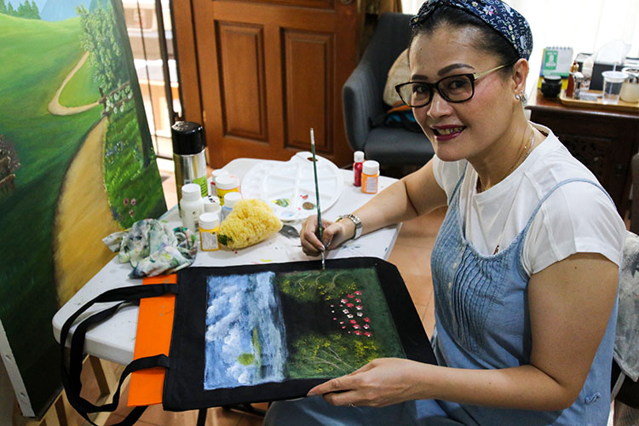
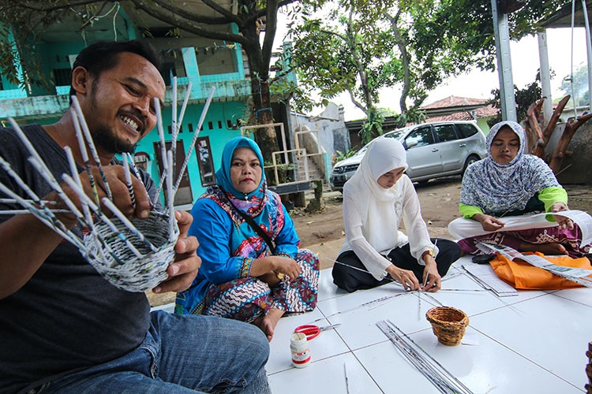
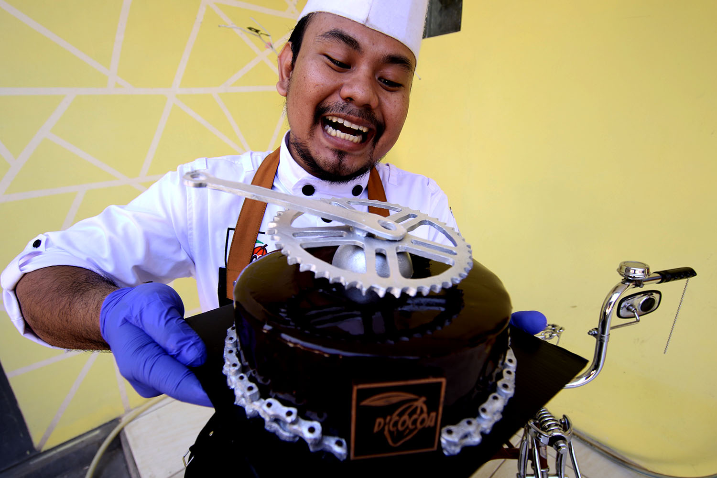
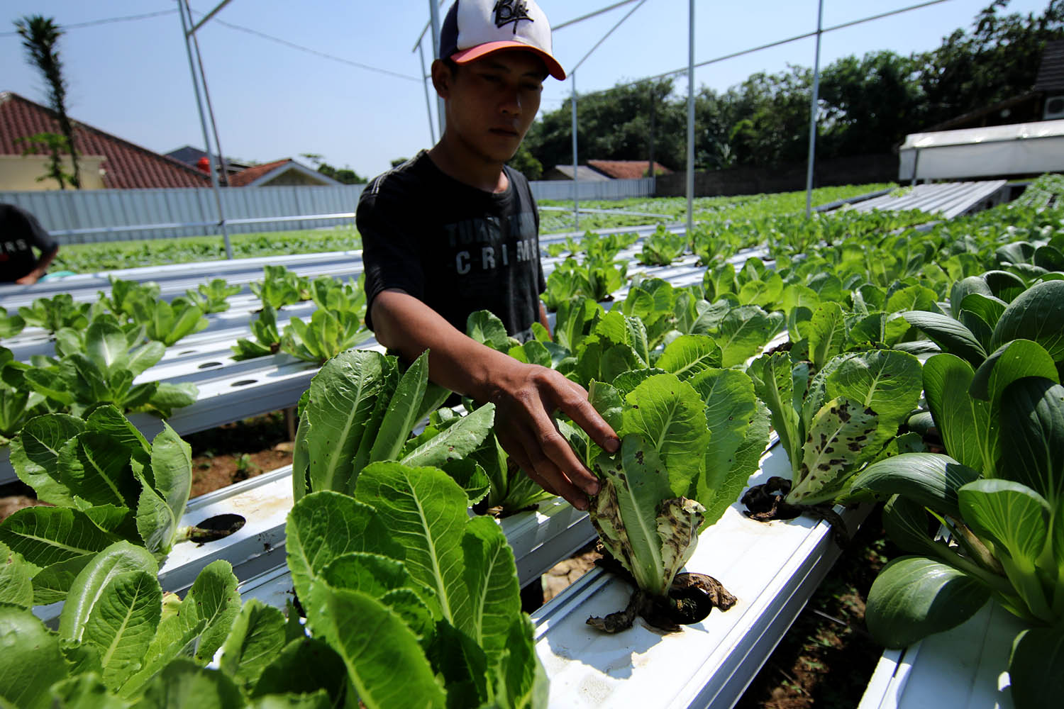
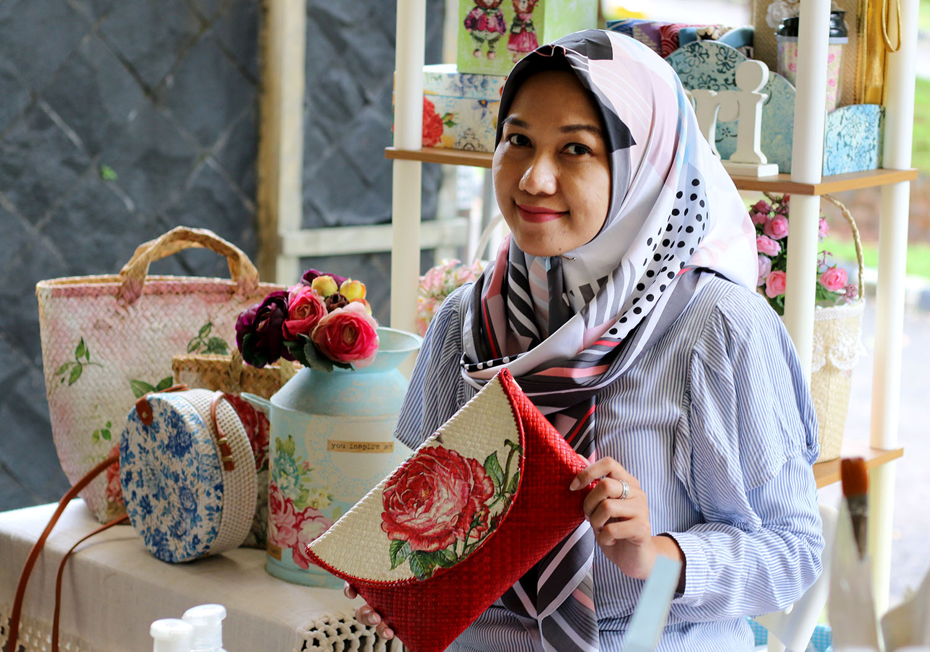
Beyond Covid-19
Village is the root of sustainable development. Development should be measured by the village welfare and equality
  Village Revitalization Program
99% of the enterprises is micro level and informal sector
The chance to strengthen the local economy
Notes:
The pandemic has given us a lessons:
Village is a root of sustainable development. The development should be measured by the village welfare and equality. The Village Revitalization Program initiated by Bina Swadaya could be the answer. This is the concept of empowering village economy by strengthening the self help groups and cooperatives.
The ultra small and small enterprises needed to be support by access to capital, capacity building , awareness raising for hygiene behavior.
The chance to strengthen local economy, The case of herbal medicine and many other else need to be continuously strengthened and able to competitive with the import and industrial products.
Thank you. Terima kasih

Slide 9
THANK YOU
eri.trinurini@gmail.com

